Slide 1
Quick sort
Quick sort is based on the divide-and-conquer approach.
Idea:
pick a pivot value from the array
partition the array around the pivot value
sort the left half
sort the right half
Advantage:
It reduces the space complexity and removes the use of the auxiliary array that is used in merge sort.

Slide 2
Quick Sort
A key step in the Quicksort algorithm is partitioning the array
We choose some (any) number p in the array to use as a pivot
We partition the array into three parts:
p
numbers less than p
p
numbers greater than or equal to p

Slide 3
Quick Sort
choose pivot: 4 3 6 9 2 4 3 1 2 1 8 9 3 5 6
search: 4 3 6 9 2 4 3 1 2 1 8 9 3 5 6
swap: 4 3 3 9 2 4 3 1 2 1 8 9 6 5 6
search: 4 3 3 9 2 4 3 1 2 1 8 9 6 5 6
swap: 4 3 3 1 2 4 3 1 2 9 8 9 6 5 6
search: 4 3 3 1 2 4 3 1 2 9 8 9 6 5 6
swap: 4 3 3 1 2 2 3 1 4 9 8 9 6 5 6
search: 4 3 3 1 2 2 3 1 4 9 8 9 6 5 6 (left > right)
swap with pivot: 1 3 3 1 2 2 3 4 4 9 8 9 6 5 6

Slide 4
Quick Sort
Algorithm: QUICK ( int a[], int p, int r)
If p < r
Then q = PARTITION ( a, p, r)
QUICK( a, p, q-1)
QUICK( a, q+1, r)
End if

Slide 5
Quick Sort
Algorithm: PARTITION ( int a[], int p, int r)
x = a[p]
i = p-1
j = r+1
While TRUE
repeat i=i+1 while a[i] <= x
repeat j=j-1 while a[j] > x
if I < j then
a[i] <-> a[j]
else
a[p] <-> a[j]
return j
End if
End while

Slide 6
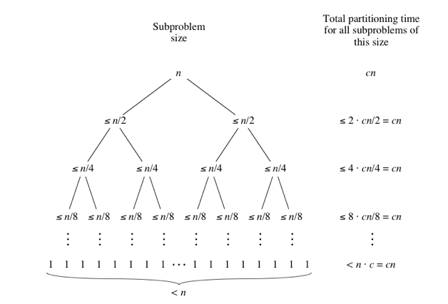
Performance of Quick Sort
Best Case: Pivot element divides the array in two equal half sub-arrays.
Thus, T(n) = 2 T(n/2) + n
Solving the above recursion, we get T(n) = ϴ(n log n)

Slide 7
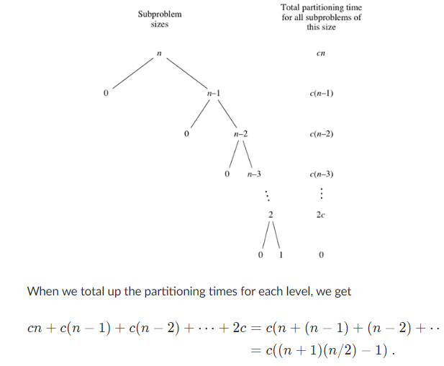
Performance of Quick Sort
Worst Case:
When the array is already sorted and the pivot element divides the array in unequal distribution. (one sub-array is empty)
Thus, T(n) = T(0) + T(n-1) + n
Solving the above recursion, we get T(n) = ϴ(n²)

Slide 8
Randomized version
Idea:
pick a random pivot value from the array
Rearrange array by swapping first element with pivot element
partition the array around the pivot value
sort the left half
sort the right half

Slide 9
Randomized Quick Sort
Algorithm: RAND_PART ( int a[], int p, int r)
i = RANDOM ( p, q)
a[p] <-> a[i]
return PARTITION ( a, p, r)
Algorithm: RAND_QUICK ( int a[], int p, int r)
if p < r
then q = RAND_PART ( a, p, r)
RAND_QUICK( a, p, q-1)
RAND_QUICK( a, q+1, r)
end if

